Slide 1
Forecasting sport shoe revenue trends USING SOCIAL MEDIA
By: Nanda Rajaraman, Anthony Igbokwe, Hanadi Hassan

Slide 2
TABLE OF CONTENTS
01
04
02
05
03
06
Project Overview
Visualization
Data Set
Model Performance
Data Cleaning/Processing
Conclusion

Slide 3
01
Project Overview

Slide 4

Project Overview
Topic: Using social media signals to predict shoe brand popularity
Goal: Predict footwear revenue using trend indicators like hashtag mentions, sentiment, and engagement
Relevance: Real-world applications in marketing, inventory planning, and trend forecasting

Slide 5
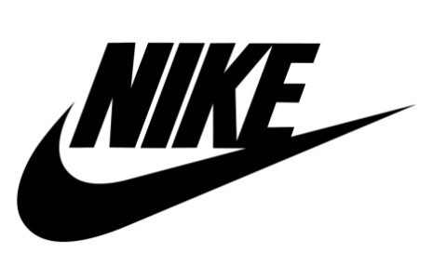



Data Set
20 rows, 4 brands (Nike, Adidas, Puma, Under Armour), 5 years (2020–2024)
Features: Revenue (target), Hashtag Mentions, Engagement Score, Sentiment Score

Slide 6
Data Cleaning/processing
Cleaned dirty dataset by replacing missing values by grouping by brand and replacing with mean
Converted Text to Numeric Categories
Imputed Missing Values by Brand
Standardized Brand Name Formatting
Removed Irrelevant Data Columns

Slide 7
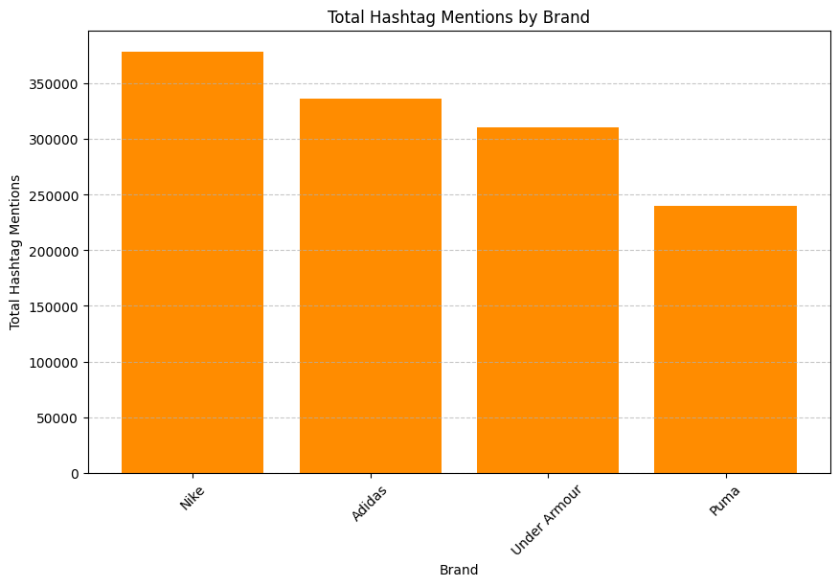
Visualization
Bar chart

Slide 8
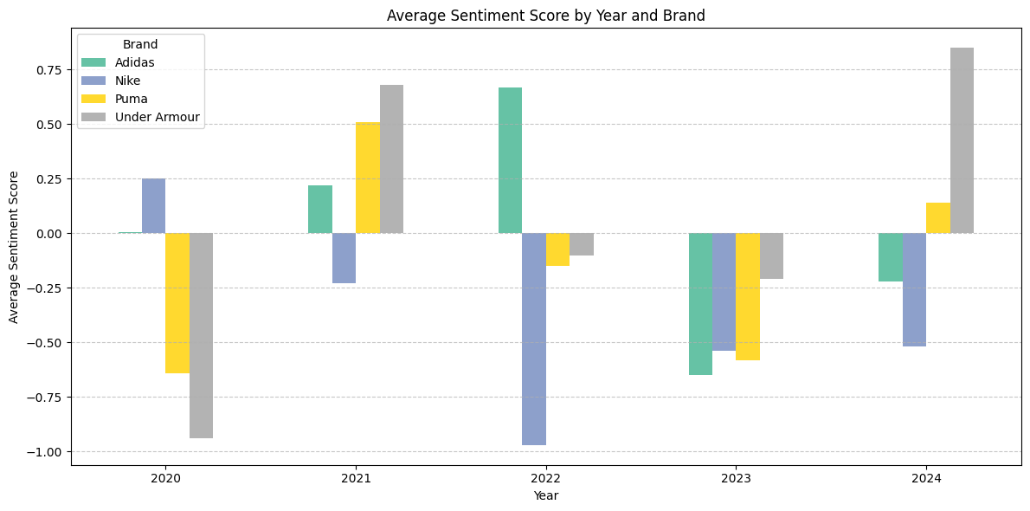
Visualization
Bar chart

Slide 9
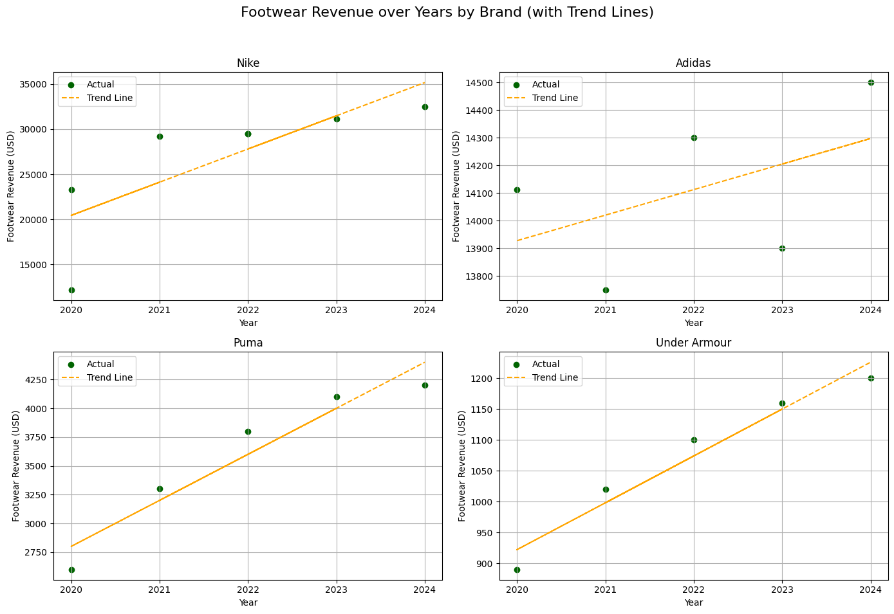
Visualization
Scatter Plot

Slide 10
Model Performance
Target Variable: Revenue
Predictors: Hashtag Mentions, Engagement Score, Sentiment Score
LINEAR REGRESSION
RANDOM FOREST
Logistic Regression
R^2 Score for Linear Regression: 0.9548778564125733 or 95.5%
Accuracy Score for Random Forest: 0.5833333333333334 or 58.3%
Accuracy Score for Logistic Regression: 0.5 or 50%

Slide 11
Conclusion
Best Model and Conclusion
The best model is clearly Linear Regression because revenue can be easily correlated with other factors to predict future revenue. In conclusion, Nike should be the most popular amongst these shoe brands based on revenue in the future based on these factors: Nike shows the steepest and most consistent upward trend in revenue from 2020 to 2024. Nike sentiment is volatile and even quite negative in 2022 and 2023, but not consistently poor like the others The machine learning models show that Nike has higher overall predicted values for revenue

Slide 12
THATS A WRAP!

